Slide 1



Welcome to Summer of Trailhead
Doug Ayers
Senior Developer @Virsys12
@DouglasCAyers
in/douglasayers
W douglascayers.wordpress.com

Slide 2
Two Approaches to Development
Team Clicks
Team Code
Page Layouts
Record Types
Lightning App Builder
Visualforce Pages
Visualforce Components
Lightning Components
User Interface
Formula Fields
Validation Rules
Workflows and Approvals
Apex Controllers
Apex Triggers
Business Logic
Custom Objects
Custom Fields
Relationships
Metadata API
REST API
Bulk API
Data Model
Notes:
When it comes to the platform there are two main channels for development. On the one hand you have team clicks--build and customize apps in Salesforce without writing a line of code. You can create objects and fields to start storing data, add in process automation like workflow or validation rules to make your apps run flawlessly on their own, and even create your own custom mobile apps with Salesforce1 or Lightning App Builder.
When you need more flexibility with things like look and feel or app functionality, you can build out your customizations with code. You have the ability to build out customizations or apps in your organization using a wide range of coding languages and platform services. We built an API first platform exposing all of the org data and metadata (given security permissions allow it) to build whatever custom app you need.
The golden rule with Salesforce app development is clicks before code, for maintainability and sustainability reasons, so think about your specs before you start to build!

Slide 3
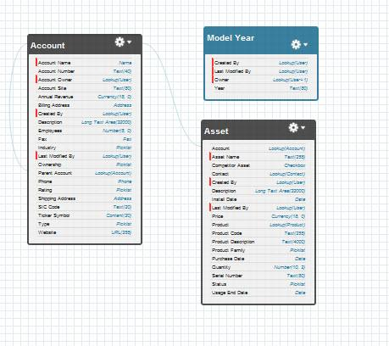


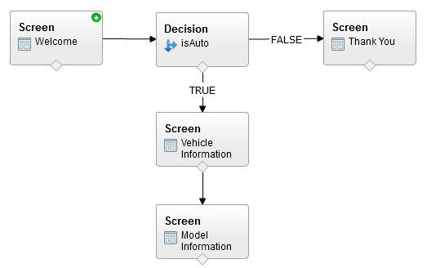
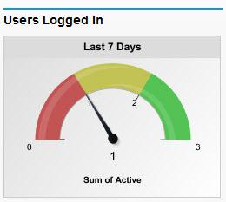
Tools for Getting the Job Done
Model
Form
Function
Flow
Analytics
Schema Builder for Easy Data Management
Form Builder for Apps, Portals,
& Sites
Re-usable Formulas, Validations
& Logic
Drag & Drop Workflow Builder for Business Processes
Drag & drop Chart & Report Builder
Notes:
If you’re asking yourself, okay but what is the platform? The simplest way to define the platform is that it’s a set of tools to get your job done. I’ve talked to folks in the community who talk about what they do at their jobs and when I ask them, “So what do you think about the platform?” they don’t even realize they are already using the platform!

Slide 4
But how do you learn
AND
keep up with all this stuff?
Notes:
So now that you hopefully have a little more understanding of what the platform is, how in the heck are you supposed to be able to learn this stuff?

Slide 5
Trailhead is a
fun, interactive, guided & FREE way for Admins and Developers to learn Salesforce
https://developer.salesforce.com/trailhead
Notes:
And thats where Trailhead comes in. Trailhead is a new way of learning Salesforce, with gamified learning paths that make learning the platform accessible and fun.
We have organized the various learning modules into trails, making it easier for all Admins and Developers to level up on their Salesforce skills.

Slide 6
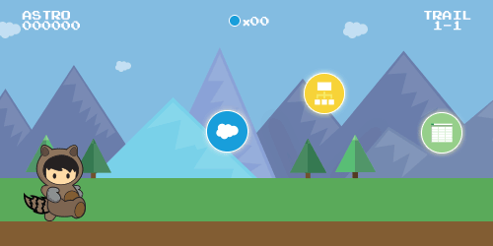
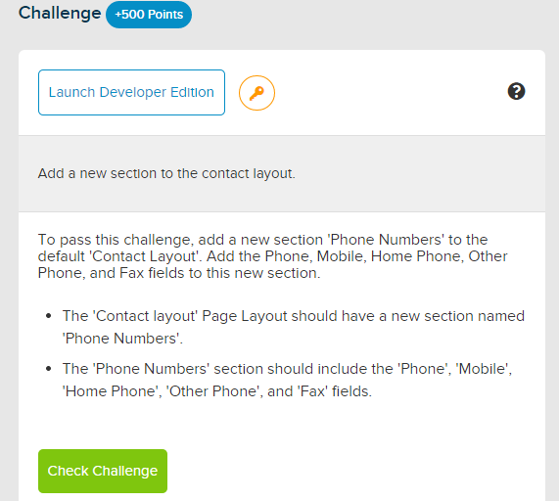
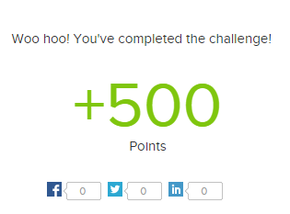
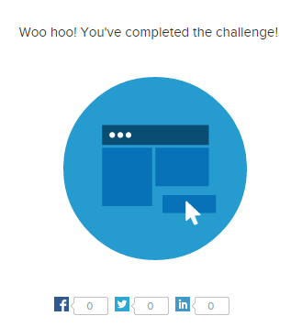
Trailhead
is fun
Challenges
Points
Badges
Notes:
So how does Trailhead work?
Each learning path is organized into trails. Take the beginner Admin trail for example. The trail is organized into bite sized, modular blocks of content that you can learn at your own pace. Each module starts with the context and backround information that you need to understand that part of of the platform, and then at the bottom there is a challenge that you can complete in order to earn points. Once you have enough points in various modules--you earn a badge!

Slide 7
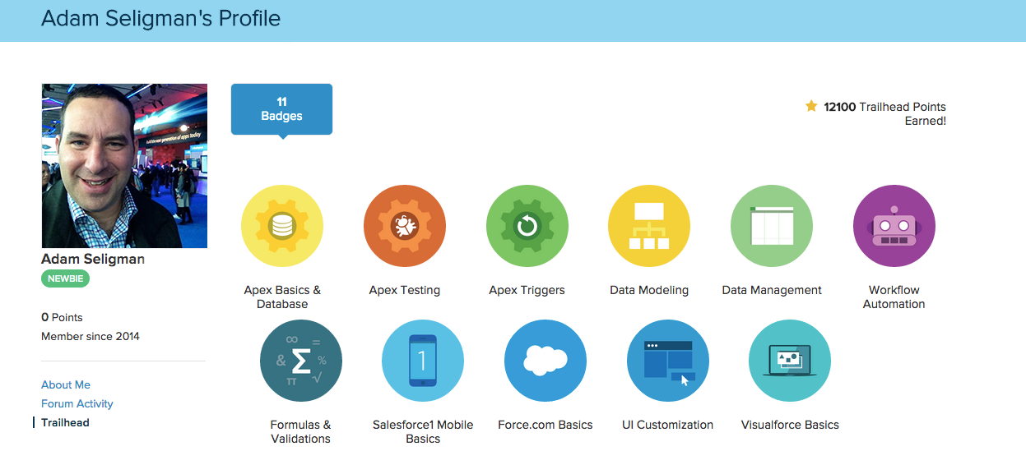
Show us your badges
Show the world your progress on Trailhead
Share your badges on Twitter! #trailhead
Notes:
And like we saw in the demo, you not only have the badges on your developer profile to show off your street cred, you can also share them on social media. Let it be known that you are kicking butt and taking names!

Slide 8
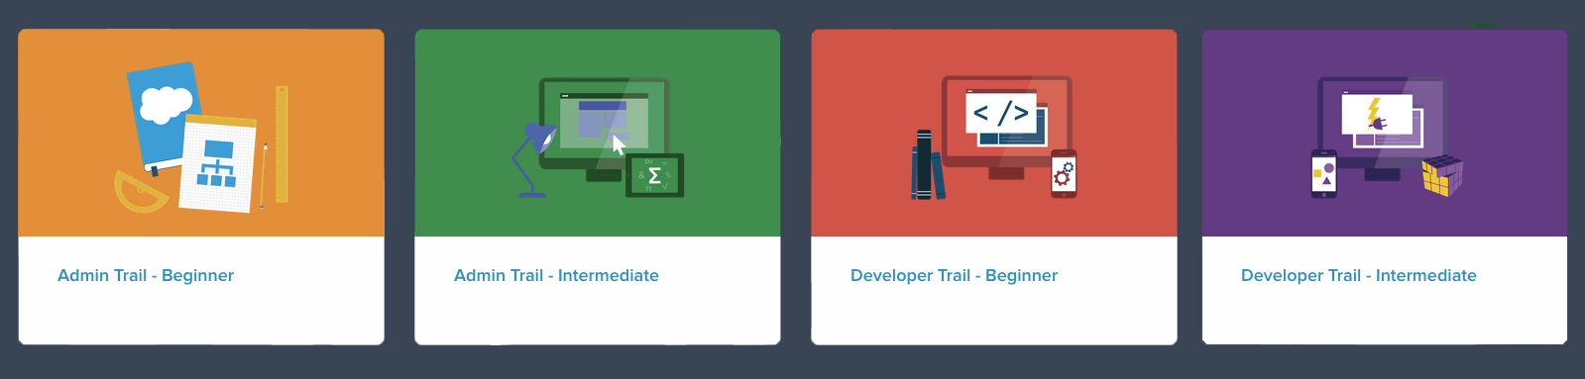
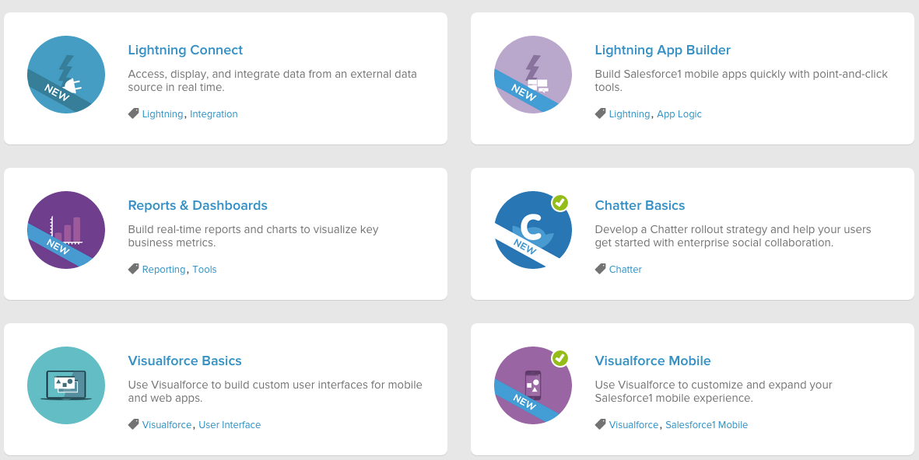
Let Trailhead guide you
…or blaze your own trail
Notes:
And we try to make it as easy as possible for you to find the modules that will be most relevant to you. If you’re just starting out at a job or maybe you’re a manager looking to help train and grow a team, we have comprehensive trails that cover the breadth of the platform for both beginning and intermediate developers or admins alike.
If you are looking to dive into a specific technology or area, you can blaze your own trail by choosing your own adventure module by module.

Slide 9
Demonstration
Notes:
But rather than just talking about Trailhead, how about I show you Trailhead.
I want to show you what Trailhead looks like and how to complete a challenge…
Demo prep: Start the challenge for the ‘Using the Report Filter’ lesson in the Reports & Dashboards Module. Either build this challenge 90% of the way through, or take a piece out/make an error so you can fix it during the demo.
Demo path:
Open Trailhead: developer.salesforce.com/Trailhead (emphasize it is on the developer domain because that is where our development team deploys code, but it is most certainly full of content for both Admins and developers)
Go into Beginner Admin Trail. Describe the flow of modules (Work from top to bottom. The order of modules is intentional, introducing concepts in that order). Scroll to the bottom and note the new modules--Trailhead is constantly adding new modules every couple weeks, so keep checking back for new content!
Open the ‘Using the Report Filter’ lesson in the Reports & Dashboards Module. Note the static content at the top (documentation, videos, resources). End with the challenge and talk about the requirements for the challenge and the login button.
Click the Login to a DE button to show the whole flow of what a person new to Trailhead should see in order to authenticate. Make sure to mention this needs to be a DE and should NOT be a production org or trial.
Once logged in, check the challenge and wait for the failure. Once it fails, note the error message and go into your org to fix the challenge. Once fixed, come back to Trailhead and check the challenge again. Note the badge/points.
Show off your badges and points. Go to your developer profile (click on your name > your name or username in the upper right) and then click the Trailhead link below your profile picture.

Slide 10
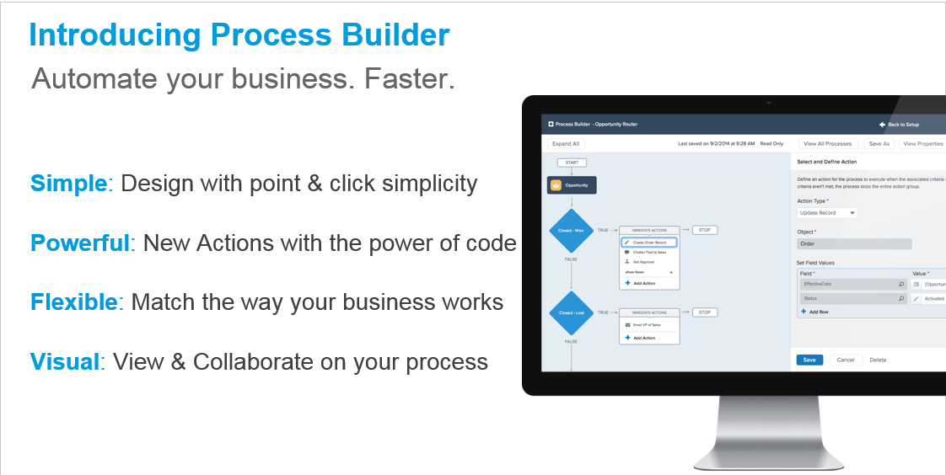

Slide 11
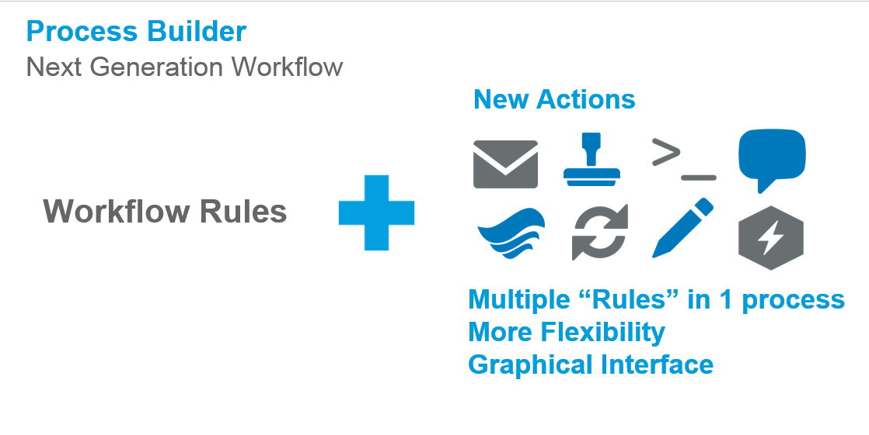

Slide 12
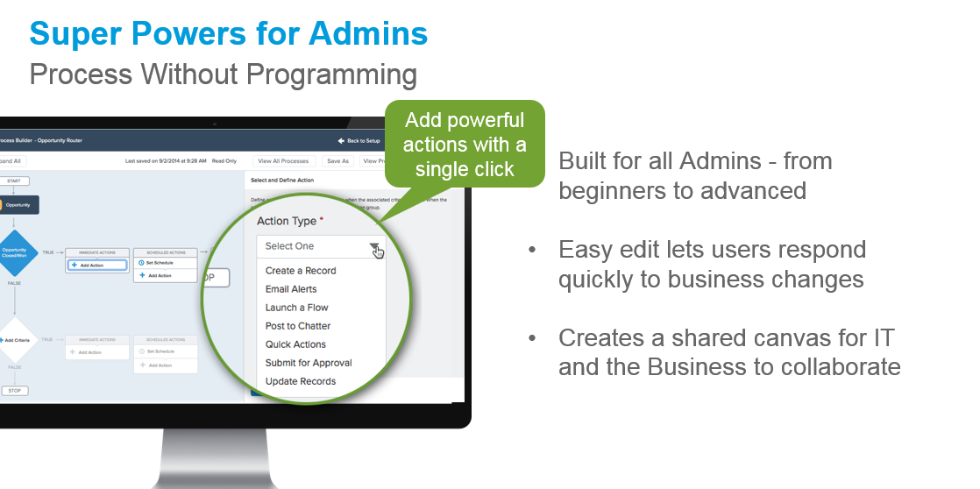

Slide 13
Summer ‘15 Enhancements
ISNEW, ISCHANGED, ISPICKVAL, INCLUDES, and PRIORVALUE functions
Math and Date functions in field expressions ( TODAY() + 3 )
Use System variables in formula expressions ( [Account].OwnerId <> $User.Id )
Use multi-select picklists in criteria conditions and formulas via INCLUDES func.
Define conditions when updating related records
Immediately delete inactive processes, no more waiting 12 hours
Process Builder user interface enhanced
http://releasenotes.docs.salesforce.com/en-us/summer15/release-notes/rn_forcecom_process.htm
Notes:
But rather than just talking about Trailhead, how about I show you Trailhead.
I want to show you what Trailhead looks like and how to complete a challenge…
Demo prep: Start the challenge for the ‘Using the Report Filter’ lesson in the Reports & Dashboards Module. Either build this challenge 90% of the way through, or take a piece out/make an error so you can fix it during the demo.
Demo path:
Open Trailhead: developer.salesforce.com/Trailhead (emphasize it is on the developer domain because that is where our development team deploys code, but it is most certainly full of content for both Admins and developers)
Go into Beginner Admin Trail. Describe the flow of modules (Work from top to bottom. The order of modules is intentional, introducing concepts in that order). Scroll to the bottom and note the new modules--Trailhead is constantly adding new modules every couple weeks, so keep checking back for new content!
Open the ‘Using the Report Filter’ lesson in the Reports & Dashboards Module. Note the static content at the top (documentation, videos, resources). End with the challenge and talk about the requirements for the challenge and the login button.
Click the Login to a DE button to show the whole flow of what a person new to Trailhead should see in order to authenticate. Make sure to mention this needs to be a DE and should NOT be a production org or trial.
Once logged in, check the challenge and wait for the failure. Once it fails, note the error message and go into your org to fix the challenge. Once fixed, come back to Trailhead and check the challenge again. Note the badge/points.
Show off your badges and points. Go to your developer profile (click on your name > your name or username in the upper right) and then click the Trailhead link below your profile picture.

Slide 14
Demonstrations
Task to Validate Account
Chatter Post Big Opportunity Wins
Sync Account Shipping Address to Contacts
Auto-Close Lost Oppty’s for Inactive Accounts
Auto-Create Account & Contact from Opportunity
https://github.com/DouglasCAyers/sfdc-summer-of-trailhead-2015
Notes:
But rather than just talking about Trailhead, how about I show you Trailhead.
I want to show you what Trailhead looks like and how to complete a challenge…
Demo prep: Start the challenge for the ‘Using the Report Filter’ lesson in the Reports & Dashboards Module. Either build this challenge 90% of the way through, or take a piece out/make an error so you can fix it during the demo.
Demo path:
Open Trailhead: developer.salesforce.com/Trailhead (emphasize it is on the developer domain because that is where our development team deploys code, but it is most certainly full of content for both Admins and developers)
Go into Beginner Admin Trail. Describe the flow of modules (Work from top to bottom. The order of modules is intentional, introducing concepts in that order). Scroll to the bottom and note the new modules--Trailhead is constantly adding new modules every couple weeks, so keep checking back for new content!
Open the ‘Using the Report Filter’ lesson in the Reports & Dashboards Module. Note the static content at the top (documentation, videos, resources). End with the challenge and talk about the requirements for the challenge and the login button.
Click the Login to a DE button to show the whole flow of what a person new to Trailhead should see in order to authenticate. Make sure to mention this needs to be a DE and should NOT be a production org or trial.
Once logged in, check the challenge and wait for the failure. Once it fails, note the error message and go into your org to fix the challenge. Once fixed, come back to Trailhead and check the challenge again. Note the badge/points.
Show off your badges and points. Go to your developer profile (click on your name > your name or username in the upper right) and then click the Trailhead link below your profile picture.

Slide 15
Why Process Builder over Workflow Rules?
Centralize multiple if/then statements and actions
Perform actions not possible with workflow rules
Visual user interface to define steps
Maintain version control over a given process

Slide 16
When to use Process Builder or Visual Flows?
UI Based Processes – Visual Flows is about user interfaces that let users progress through a wizard style UI. Interactive and manually launched.
Record Based Processes – Process Builder are actions you define to occur behind the scenes in response to records being created or edited. Non-interactive and automatically launched.

Slide 17
Best Practices
Check – to see if there are any workflows or triggers on the object doing the same thing as the process.
Avoid – interweaving Apex, Workflow, and Processes together for the same process. Unpredictable behavior.
Document – use description field to explain why.
Test – and test some more. Sandbox first!

Slide 18
But how do you learn
AND
keep up with all this stuff?
Notes:
So now that you hopefully have a little more understanding of what the platform is, how in the heck are you supposed to be able to learn this stuff?

Slide 19
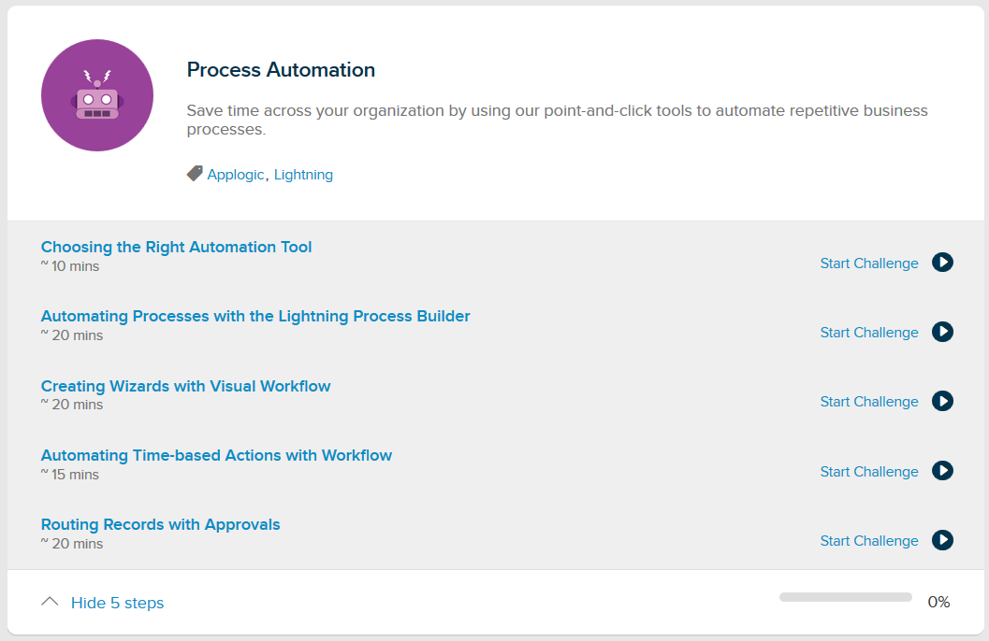
https://developer.salesforce.com/trailhead/module/business_process_automation
Notes:
But rather than just talking about Trailhead, how about I show you Trailhead.
I want to show you what Trailhead looks like and how to complete a challenge…
Demo prep: Start the challenge for the ‘Using the Report Filter’ lesson in the Reports & Dashboards Module. Either build this challenge 90% of the way through, or take a piece out/make an error so you can fix it during the demo.
Demo path:
Open Trailhead: developer.salesforce.com/Trailhead (emphasize it is on the developer domain because that is where our development team deploys code, but it is most certainly full of content for both Admins and developers)
Go into Beginner Admin Trail. Describe the flow of modules (Work from top to bottom. The order of modules is intentional, introducing concepts in that order). Scroll to the bottom and note the new modules--Trailhead is constantly adding new modules every couple weeks, so keep checking back for new content!
Open the ‘Using the Report Filter’ lesson in the Reports & Dashboards Module. Note the static content at the top (documentation, videos, resources). End with the challenge and talk about the requirements for the challenge and the login button.
Click the Login to a DE button to show the whole flow of what a person new to Trailhead should see in order to authenticate. Make sure to mention this needs to be a DE and should NOT be a production org or trial.
Once logged in, check the challenge and wait for the failure. Once it fails, note the error message and go into your org to fix the challenge. Once fixed, come back to Trailhead and check the challenge again. Note the badge/points.
Show off your badges and points. Go to your developer profile (click on your name > your name or username in the upper right) and then click the Trailhead link below your profile picture.

Slide 20
Resources
https://rakeshistom.wordpress.com
https://developer.salesforce.com/trailhead/business_process_automation/process_builder
http://gearscrm.com/overview-of-salesforce-process-builder
http://www.arkusinc.com/archive/2015/go-lightning-fast-with-process-builder
http://thewizardnews.com/wizards-apprentice
http://bobbuzzard.blogspot.com/2015/02/lightning-process-builder-and-invocable.html
http://andyinthecloud.com/2015/03/01/extending-lightning-process-builder-and-visual-workflow-with-apex/
https://help.salesforce.com/HTViewHelpDoc?id=process_overview.htm
https://help.salesforce.com/HTViewHelpDoc?id=process_which_tool.htm
https://help.salesforce.com/apex/HTViewSolution?urlname=Scheduled-Actions-from-Process-Builder-do-not-use-the-current-record-values-when-the-scheduled-action-is-processed

